Slide 1
Identifying HARPed Loans
February 2016

Slide 2
OVERVIEW OF HARP AND STREAMLINE REFI PROGRAMS
Key Differences in Streamline Refi, HARP 1.0 and HARP 2.0 Programs
 | HARP 2.0 | HARP 1.0 | Streamline Refi
Period | Since November 2011 | April 2009 – October 2011 | Pre-HARP 1.0
Appraisal | Mostly Automated | Manual/automated appraisal but manual appraisal required in most cases | Manual appraisal
Income & Asset documentation | Reduced requirement in September 2012--same servicers are required to verbally verify a borrower's income; New lenders are required to have documentation | Need documentation; in some cases need two year history of income | Stated Income/employment
Reps & Warrants | Further relief of reps & warrants for original loan in September 2012; Relief of new loan reps & warrants risk with 12 month clean pay following origination | Seller retains all the original reps & warrants regarding value condition and marketability; no additional relief on the new loan | Any previous rep & warrant relief on the original loan does not apply to the new loan
LTV restriction | Extended to above 125% LTV in October 2011 | LTV ceiling at 105% when announced in March 2009; Raised ceiling from 105% to 125% in July 2009 | under 95%-100%
MI | MI transfers made easier | No new MI required but transfer of MI is cumbersome | New MI required
LLPA | Lowered LLPA to 75bp max | Standard | Standard
Source: Citigroup Research

Slide 3
INTRODUCTION
1
Importance of identifying HARP loans
Loans that have been refinanced through the Home Affordable Refinance Program (HARP) generally prepay slower than other refinance loans that have undergone full underwriting. As a streamline refinance program, HARP generally made only minimal requirements of borrowers, and such borrowers may subsequently have trouble qualifying for regular refinances.
2
Existing algorithms for identifying HARPed Loans
Prior to August 2013:
This is the period prior to Freddie Mac providing loan-level credit information for fully underwritten mortgages
MI matches were used to identify potential HARPed loans with OLTV > 80% and loan purpose as Refi-NCO (No Cash-out)
Although HARP targets with LTVs > 80%, loans with lower OLTVs are counted as part of HARP because the Agencies essentially suspended their streamline refi programs after the financial crisis and currently rely on the HARP program for all streamline processing
After August 2013:
New Freddie Mac and Fannie Mae loan-level credit information are used to identify 30-year fixed –rate HARP loans by mapping the credit dataset to the standard database without restrictions on the LTV ratio
The credit data set has about a one year lag, which means that recently originated loans cannot be identified as being HARPed or not using the current algorithm

Slide 4
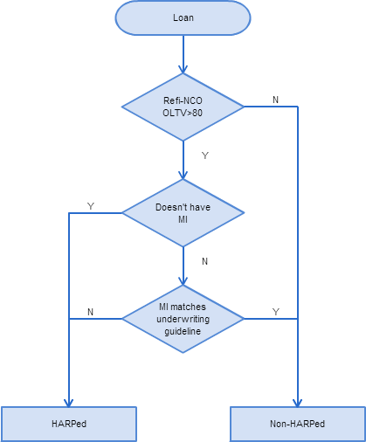
EXISTING ALGORITHM I MI Matching Method
Three Step Mapping
Step 1: The loan should be originated after June 2009 as a refi-NCO loan, with Origination LTV >80%. Otherwise, it’s Non-HARPed.
Step 2: If the loan doesn’t have MI, we match it as HARPed loan;
If not, go to step 3.
Step 3: For the loans that potentially carry over MI check whether MI matches current underwriting guidelines. If there’s no match, then it’s a HARPed loan.
Cons
Cannot match loans with OLTV equal or lower than 80%.
Highly sensitive to the correctness of MI underwriting guidelines.

Slide 5
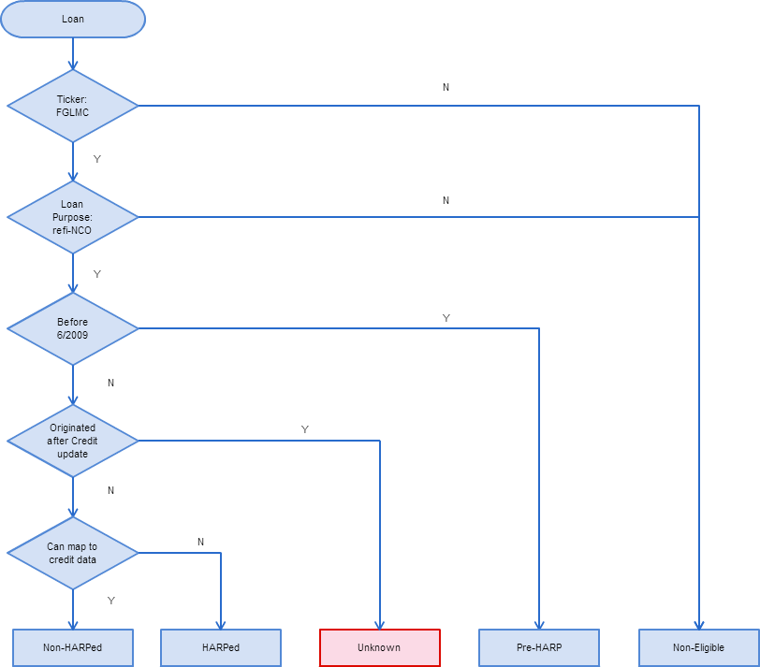
EXISTING ALGORITHM II Credit Dataset Mapping Method
Credit Data Mapping
No restrictions on OLTV > 80%.
More accurate as there is no dependency on MI underwriting criteria.
Cons
The credit data set has about a one year lag, meaning we don’t have the most recent origination data. Consequently, we have to mark the HARP status as unknown for recently (within the last year) originated loans.

Slide 6
EXISTING ALGORITHM II Results from the Credit Dataset Mapping Method
Pre-HARP
HARPed
Non-HARPed
Non-eligible: Purchas, refi-CO
The blue area can be consider as non-HARPed loans; brown area is HARPed loans percentage.
Red area is the loans originated within the most recent year. The credit dataset has a gap on this area.
Need to improve the mapping for the red area.

Slide 7
ENHANCED ALGORITHM FOR RECENTLY ORIGINATED LOANS
Y: HARPed
HARP% = 100
LTV > 80%
MI Test
Using Algo I
N: Non-HARPed
HARP% = 0
HARP % for each loan
Recently Originated Refi Loans
LTV <= 80%
Logistic Regression Model*
Likelihood that loan has been HARPed
We estimate the likelihood that the loan is originated from the HARP program for each loan.
*Model parameters will be different for FNMA vs FHLMC since FNMA does not distinguish between cash-out and non-cash out refinances.

Slide 8
MI ALGORITHM APPLIED TO RECENTLY ORIGINATED LOANS WITH LTV > 80% Is an Adjustment Needed?
How good is the MI matching algorithm at identifying HARP loans with LTV > 80%? We backtested the algorithm on HARP loans identified by the Credit Dataset matching algorithm. The HARP mapping numbers from them are fairly close to each other. Consequently, there is no need to apply an adjustment factor when running the MI algorithm on recently originated LTV > 80% loans.

Slide 9
IDENTIFYING HARPed LOANS WITH LTV <= 80%
Logistic Regression Model for the HARPed Percentage
For loans with LTV <= 80%, and originated after the most recent available credit data set, we cannot use neither Algorithm I or Algorithm II to estimate the percentage of loans that are HARPed. In order to solve the problem, we introduce a logistic regression model based on loan characteristics and global estimates of the refinanceable universe. The algorithm is calibrated based on the HARPed vs non-HARPed breakout generated by the Credit Dataset matching algorithm.
$$HARPed Percentage \sim Credit Score+SATO+OrigLoanSize+Refi \%+HARP Eligible \%$$
Loan Characteristics:
Credit Score: The lower the credit score, the higher probability the loan is HARPed.
SATO: Borrowers with higher spreads normally have higher HARPed probabilities
OrigLoanSize: A lower loan size is associated with a higher chance that a loan is HARPed.
Refinanceable Universe Indexes:
Refinanceable Percentage: The percentage of all loans that have > 50bps incentive to refinance. When the Refi % is higher, the HARPed % of all refinance loans is lower (HARP-eligible loans prepay less dynamically than non-HARP-eligible loans) .
HARP Eligible Percentage: Higher ratios imply that the probability of a loans being HARPed is higher.

Slide 10
IDENTIFYING HARPed LOANS WITH LTV <= 80% Model Results
Logistic Regression Model for HARP Percentage
The graph below represents an out-of-sample test of our regression model. The model is trained using 80% of HARPed vs non-HARPed dataset, while holding out the remaining 20% as out-of-sample test set.

Slide 11
RESULTS FROM THE FULL ALGORITHM
Pre-HARP
HARPed
Non-HARPed
Non-Eligible: Purchas, refi-CO
Using the Enhanced Algorithm
Pre-HARP
HARPed
Non-HARPed
Non-Eligible: Purchas, refi-CO

